Slide 1
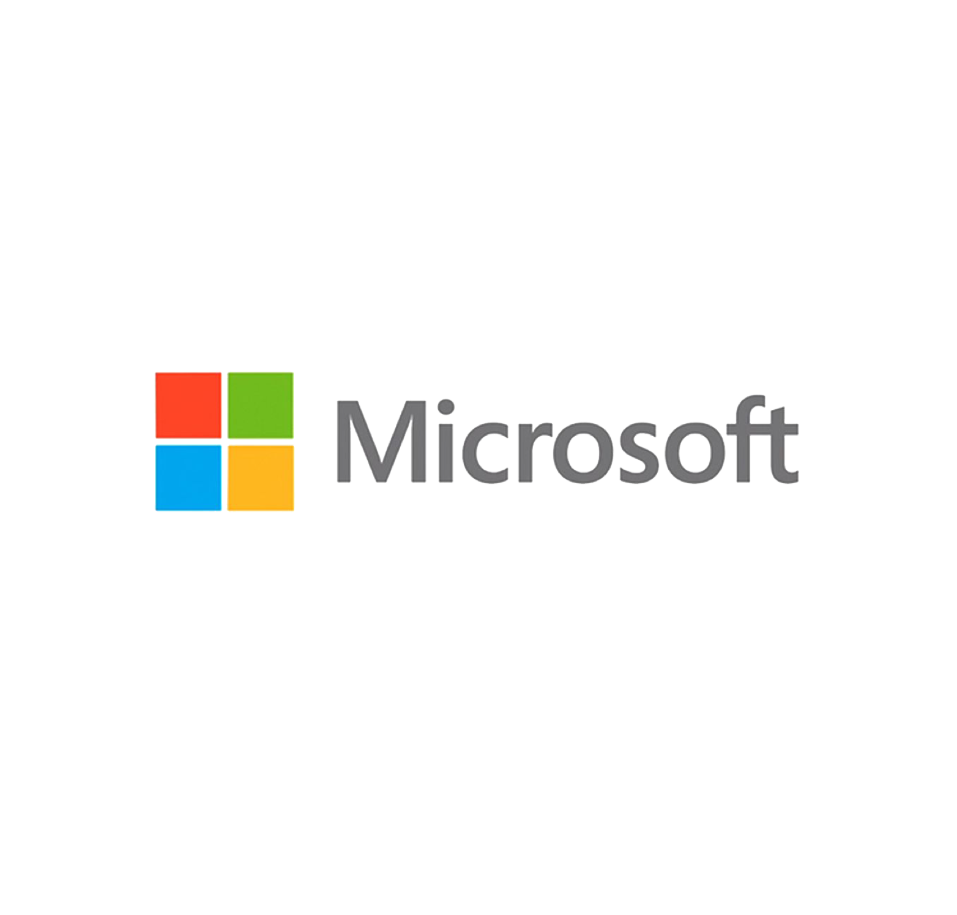

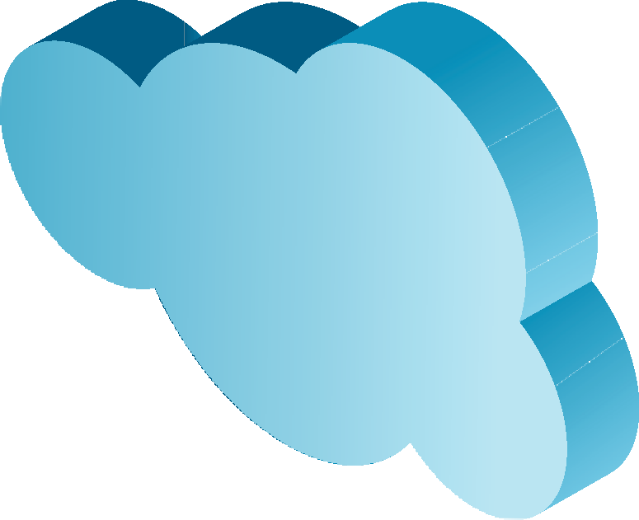












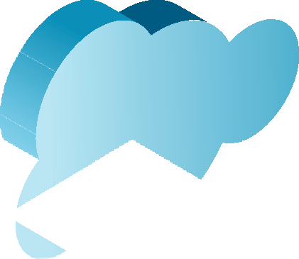
































































































“IT Matters” Forum
December 2019
Enterprise Portfolio
Modernization (EPM)
Modernize your business to get ahead and stay ahead

Slide 2
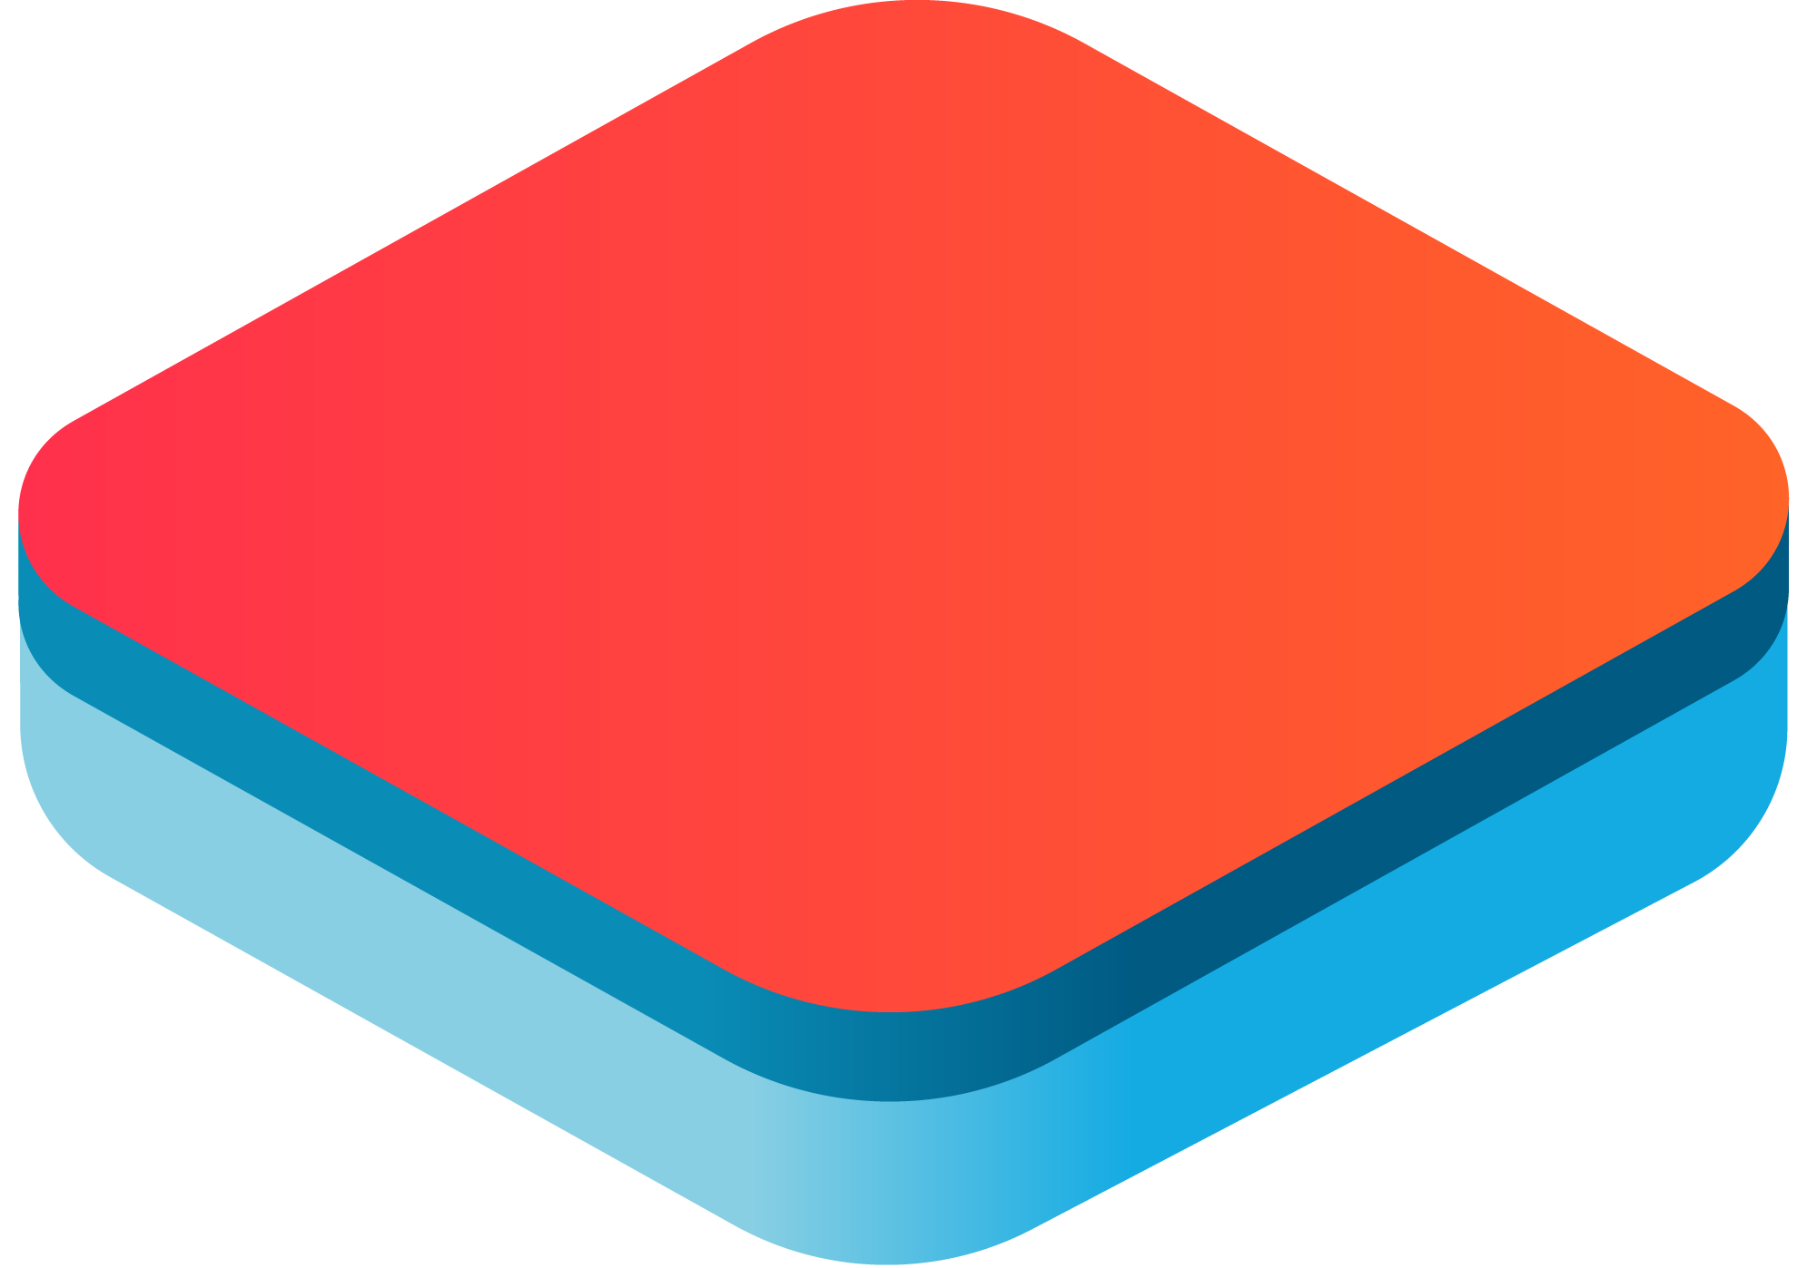
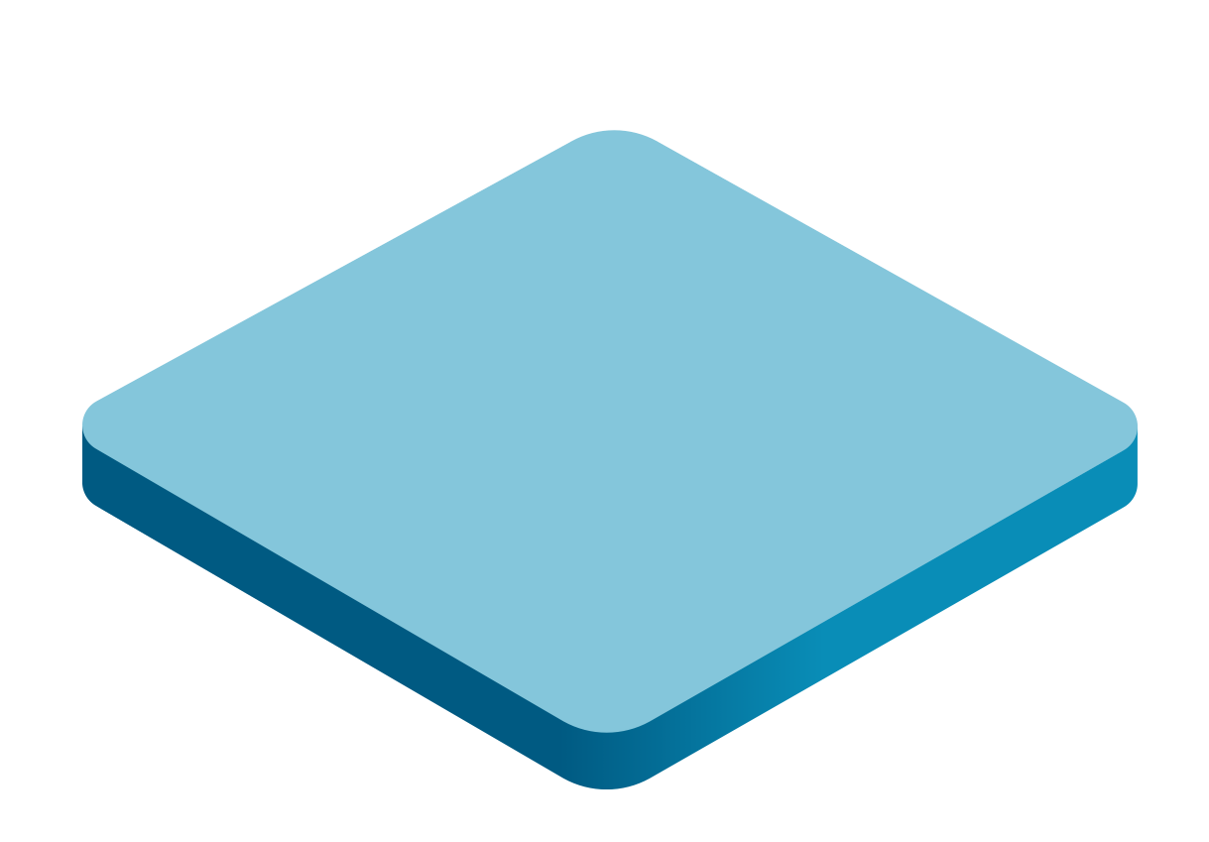
Why Modernize your Applications by Moving to the Cloud ...
Cost reduction
Strong deadlines
Bottom line impact
IT Push
Agility and Flexibility
Time to market
Top line impact
Business Push
Risk management
S/W and H/W refresh
Security threats
Urgent capacity needs
Compliance
Quickly integrate acquisitions
Application innovation
Datacenter
Contracts expiry
Software end
of support
Migration and
modernization
Triggers
Source: Microsoft – July 2019 Azure Migration Program Overview

Slide 3
Sound familiar?
What we took away and solved...
You are looking for a one stop shop
that brings together all the different elements in a single approach, aligned with best practice guidance
You need consistency you can trust
to provide ongoing support, optimization, modernization and innovation
You need technical guidance and best practices
tailored to the unique scenarios your business works in
You need support in driving change management
Both internally and developing new Azure skills amongst existing resources
Fragmented approaches to cloud migration and native development? Multiple POCs, tools & vendors = Hard to scale!
Lack of in-house skills? Silos of skills developing?
Technical Guidance & Best Practices not standardized or easily shared?
Meaning... You’re not getting the Cloud benefits & Innovation promised

Slide 4
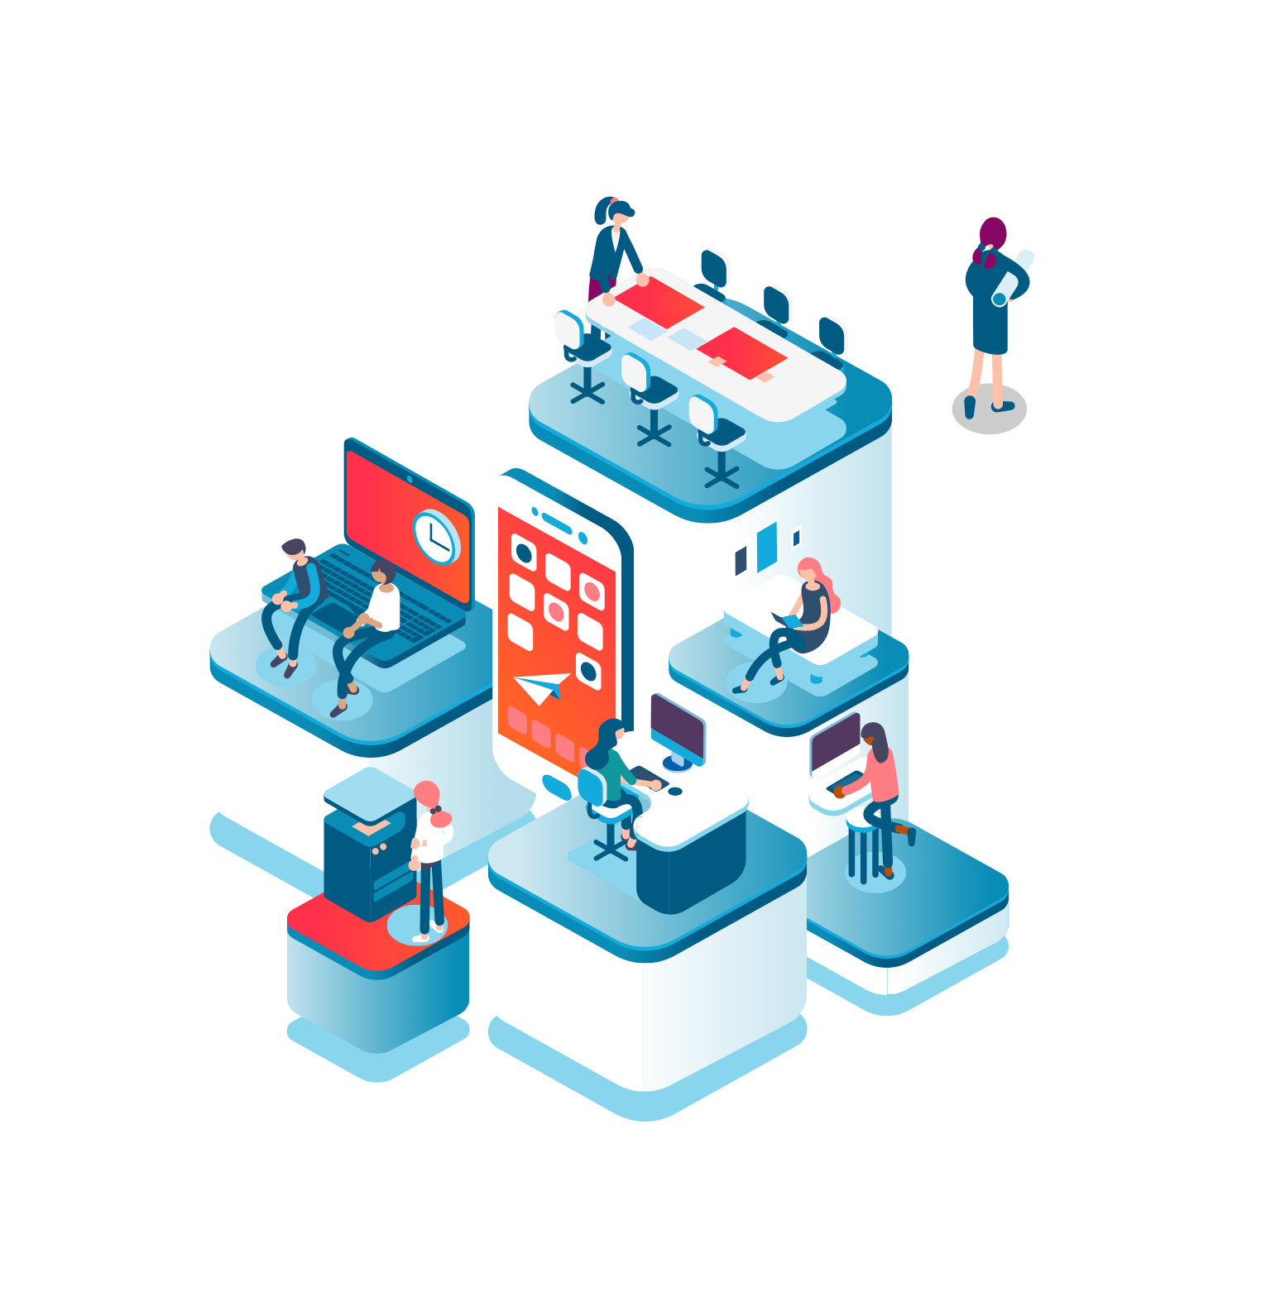
‘Cloud Transformation has evolved…
Now Cloud Transformation is about Agility and flexibility to enable Innovation…
  More focus now on leveraging Platform as a Service (PasS) and rebuilding applications on Cloud
  More organizations moving to Public Cloud.
  Multi-Cloud and Hybrid cloud strategy supported by Containerization (Kubernetes / API management / Microservices / Serverless).
At first Cloud Transformation was about optimization of assets…
  To get Cost reduction / Data storage / Disaster recovery.
  Purely on Infra as a Service (IaaS).
  Concerns around security – Private versus Public Cloud.
  Moving to SaaS solution for COTS applications ( Salesforce / 0365 etc.. )
Notes:
Why Public Cloud ?
Grow three times faster (15% - 2022) than total tech spending
Cloud is mainstream for CIO – any Sector any Geography.
CIO Challenges are about Cost (operation) and Agility (Innovation).
Cloud Platforms Are The Fastest Growing category.

Slide 5
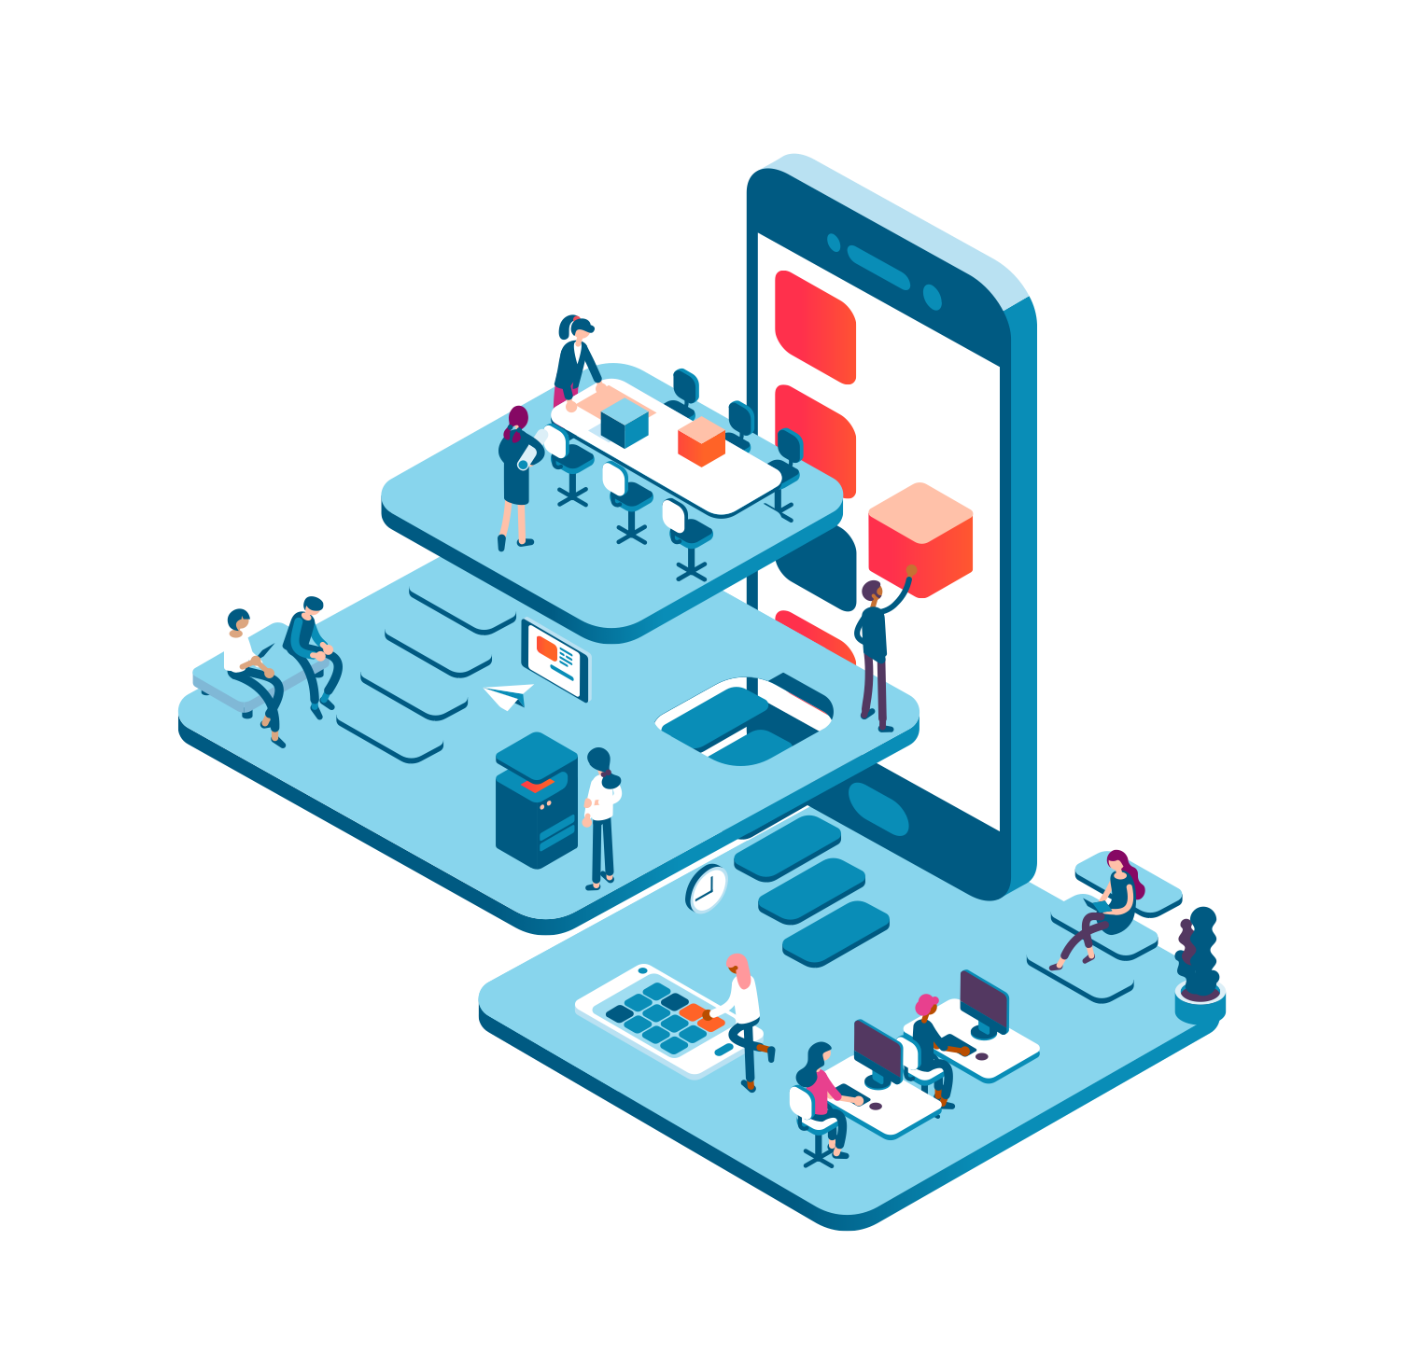
What our clients achieve with EPM
Identify your IT and business needs
Comprehensive Application discovery and assessment
Roadmap application landscape to Cloud
Align your cloud migration with business strategy
Accelerate your migration to Cloud
Futureproof for application innovation
Minimise cost, risk, and disruption
Automate migration processes using our accelerators and assets
Achieve digital transformation
Realise differentiating new capabilities and business models
Respond rapidly to changing market realities
Deliver new services and customer experiences

Slide 6
So... what is EPM?
Its Sogeti’s end to end solution made up of OneMigrate & OneNative that takes care of your Cloud adoption, and it’s specifically for Microsoft Azure.
      It contains our library of assets to accelerate your START and build a foundation that truly scales along the Journey – we call it CloudBoost
      It’s our OneMigrate service that starts with an assessment and helps you MOVE to Azure with an automated migration path.
      It’s our OneNative services that help you BUILD quickly on Azure, and optimise your applications using our assets
      & It’s our comprehensive set of Microsoft Expert accredited Managed Services help you PERFORM on Azure
PS You can even buy Azure from us ...
1
2
3
4

Slide 7
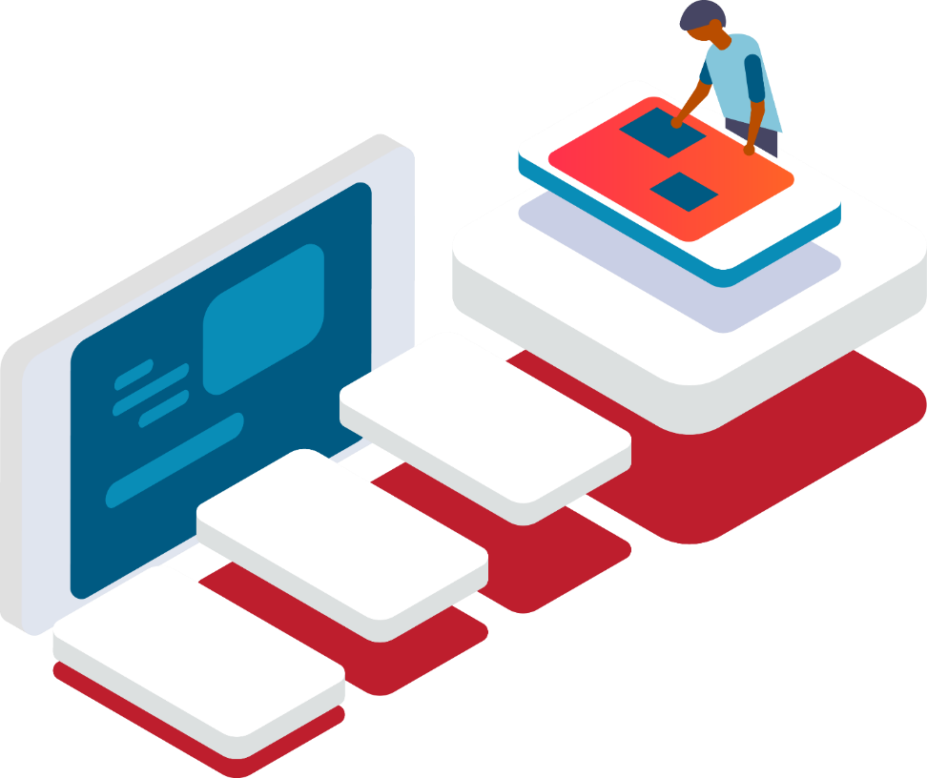

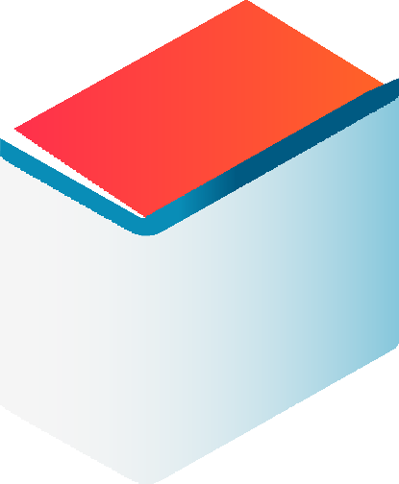
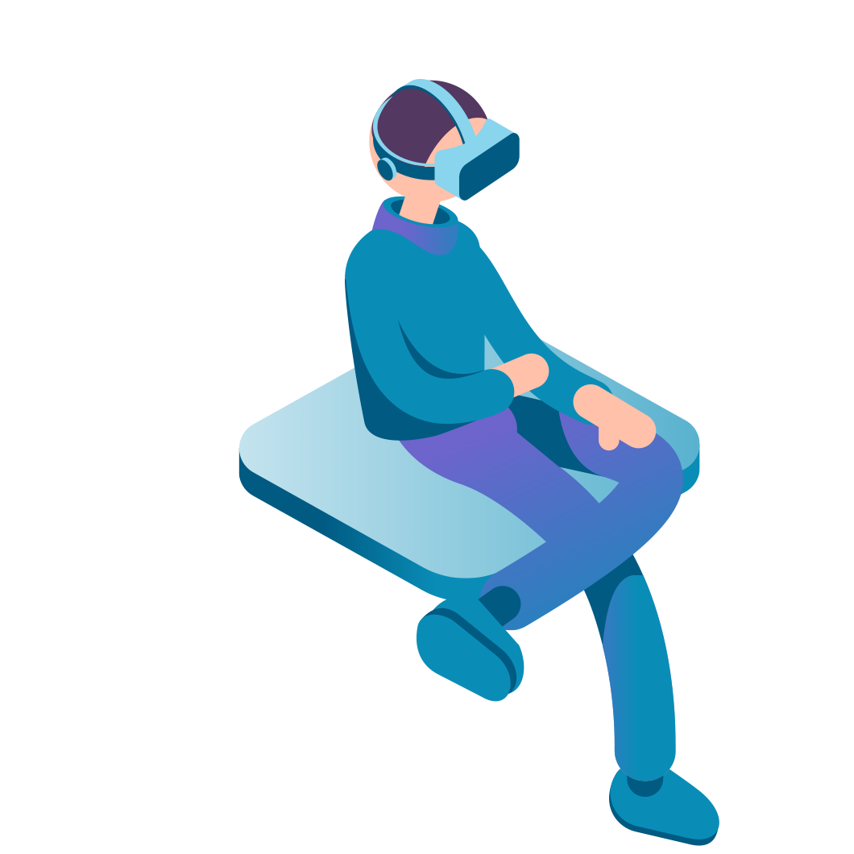
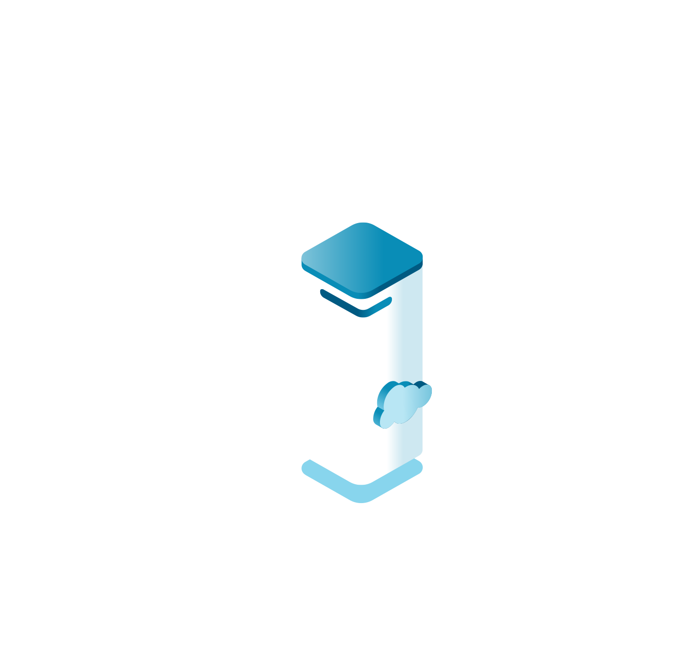
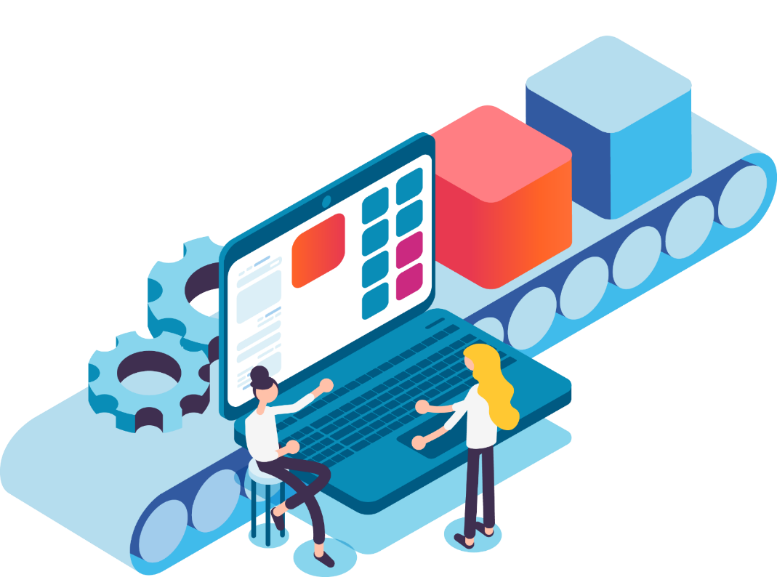
How it works for the whole Cloud Journey…
HELP ME PERFORM
ON THE CLOUD
2
HELP ME MOVE
TO THE CLOUD
OneMigrate
Modernize & Migrate your existing applications
4
HELP ME BUILD
ON THE CLOUD
CSP
HELP ME
START
FOR THE CLOUD
Through Managed Services and Cloud Solution Provider agreements with Microsoft we can provide Pay as you go billing + we handle it all
1
3
CloudBoost
Library
Cloud Platform
OneNative
The ready to go transformation platform we put you on
Maintained & Re-usable Enterprise grade Cloud Knowledge, Assets & Best Practice
Innovate, build new applications and get agility in your business by building Cloud Native apps
Delivery Centers
1
Right shore Model with Local Teams supported by global Microsoft Azure Expert accredited delivery centers

Slide 8









We use our CloudBoost Library to create the perfect
Landing Zone for your applications and processes.
1
Benefits
Save >30% time and money with our clear and proven migration paths.
Assets in our CloudBoost library serve both Migrations and Cloud Native development .
Gartner’s ‘five R’s’…
Rehost (lift&Shift)
Refactor (VM, container or PaaS)
Revise (code changes)
Rebuild (business Process Change)
Replace (SaaS) / New (Cloud Native)
OneMigrate
(Move)
The Sogeti Advantage
OneNative
(Build)
MSP Certified – Microsoft.
RightShore delivery model with local, near and off-shore delivery centers.
Adaptable delivery models at the pace of the customer
Migrate (Move) and Development (Build) teams are together
Landing Zone

Slide 9

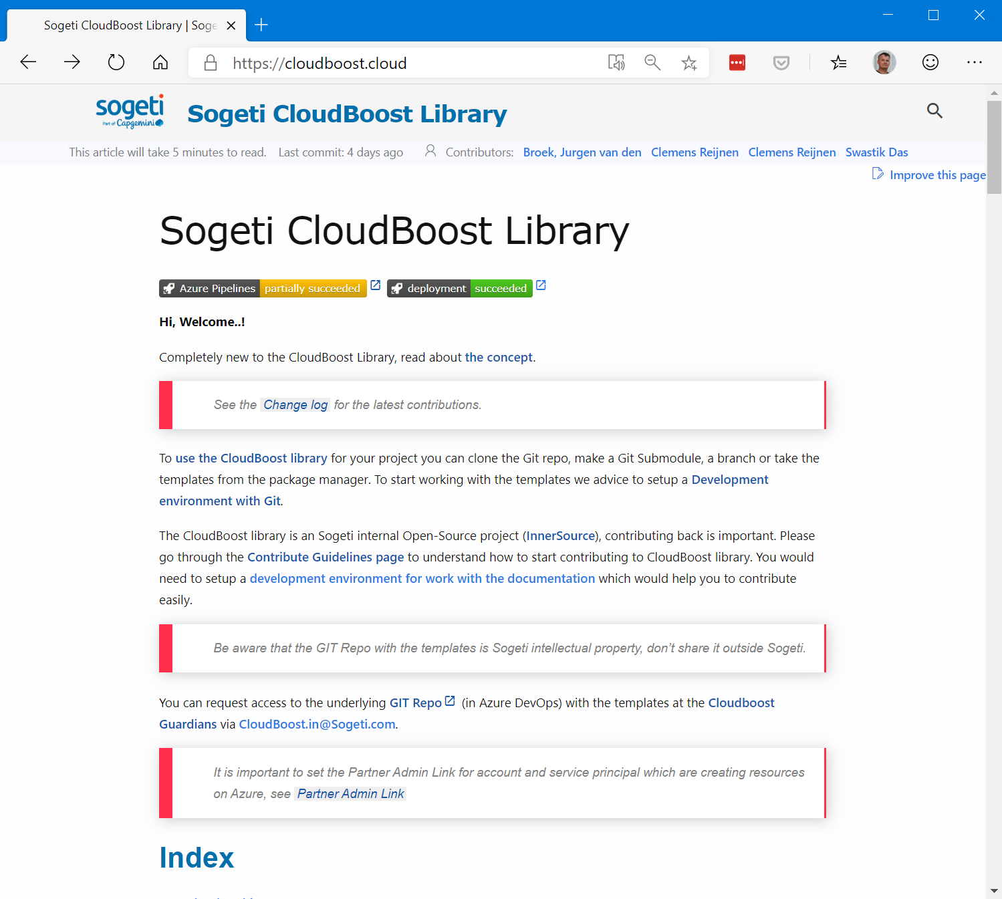
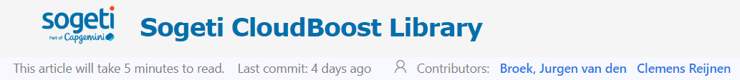
Sogeti Cloudboost Library

Slide 10

In summary with EPM:
Sogeti Advantages
We’re a Trusted Partner
We transform at your speed
We address both Infrastructure and Application transformation with a DevOps methodology
We support full migration and managed services via a unit based pricing model
We offer Technical Guidance & Best Practices
We support your innovation
We give you the templates, tools and artefacts to boost your journey to the Cloud – Our CloudBoost Library.
We define your journey & migrate your applications to the Cloud with Automation for Re-Host and Re-Factor.
We integrate those applications in the cloud, or build Cloud Native applications to create new services fast
We improve your business velocity & reduce your time to market
We reduce your costs & improve reliability
We’re a One Stop Shop for all your Cloud needs
  Start – Move – Build - Perform

